Slide 1
IMS Project
Nilay Sanghrajka
17/07/2020

Slide 2
Scope
Code a command line interface program.
Using Kanban board
Jira
Github
Testing

Slide 3
Technologies
Version Control – Git
Source code management – Github
Kanban Board – Jira
DBS System – MySql
Back-end programming Language – Java
Build Tool – Maven
Testing - Junit

Slide 4
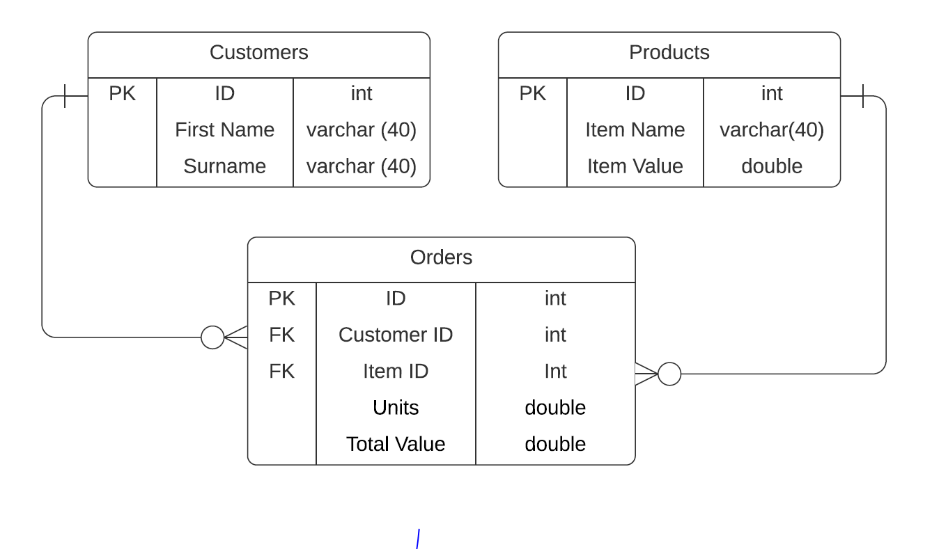
ERD Diagram

